Slide 1


Dev-Pro Node.js
Advanced Flow
Lesson 3. Networking, WEB and error handling.

Slide 2

Agenda:
NET
DNS
HTTP/HTTPS
Error handling
Domain
Async wrap

Slide 3

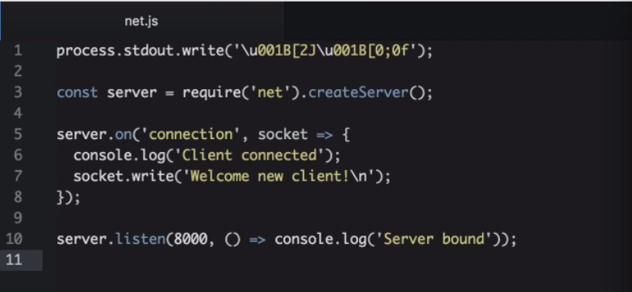
NET Module

Slide 4
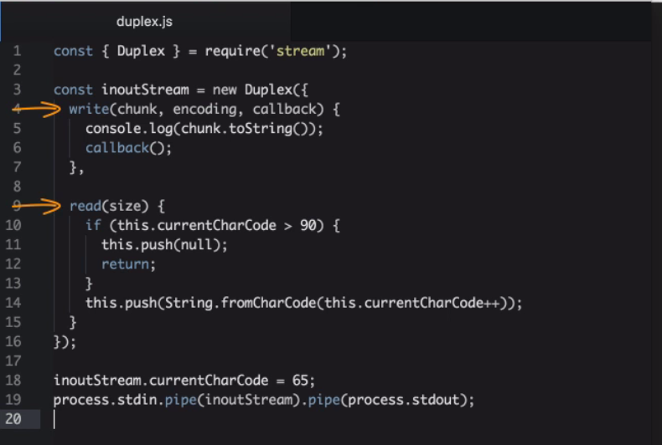
Remember Duplex Stream?

Slide 5
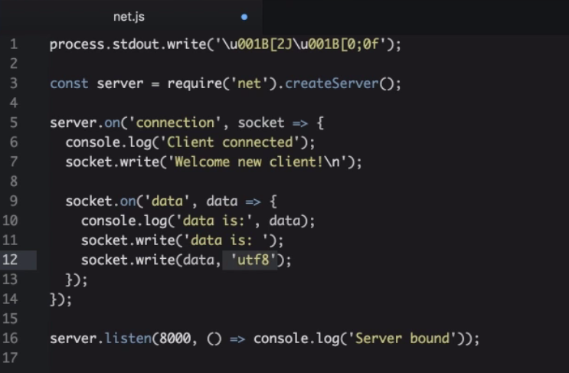
Socket is Duplex Stream!

Slide 6
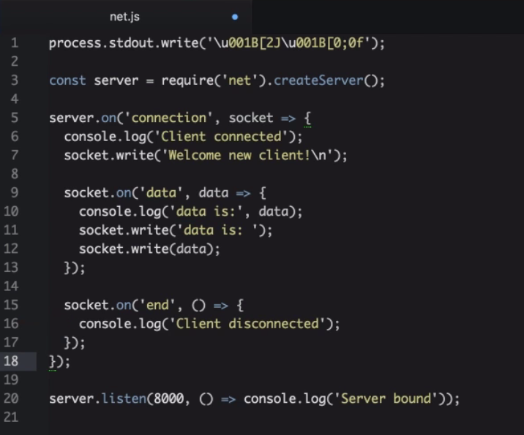
Disconnected

Slide 7
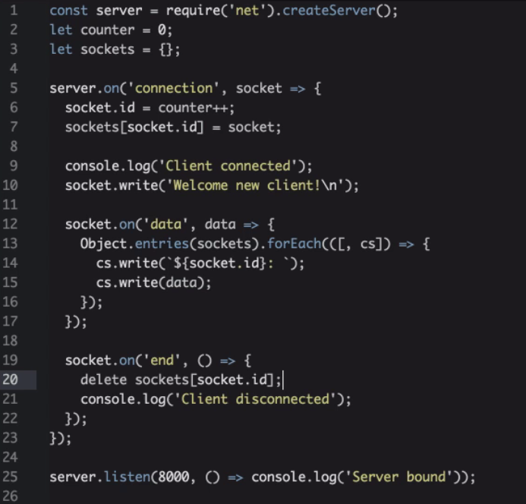
And multiple sockets

Slide 8
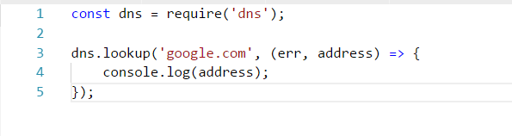
DNS module

Slide 9
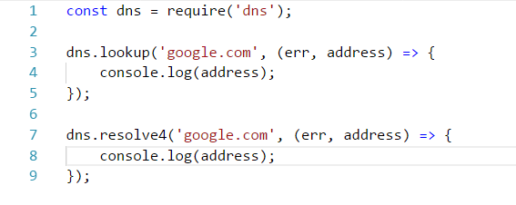
DNS module

Slide 10
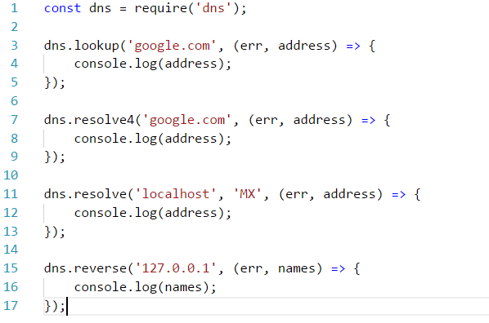
DNS module

Slide 11
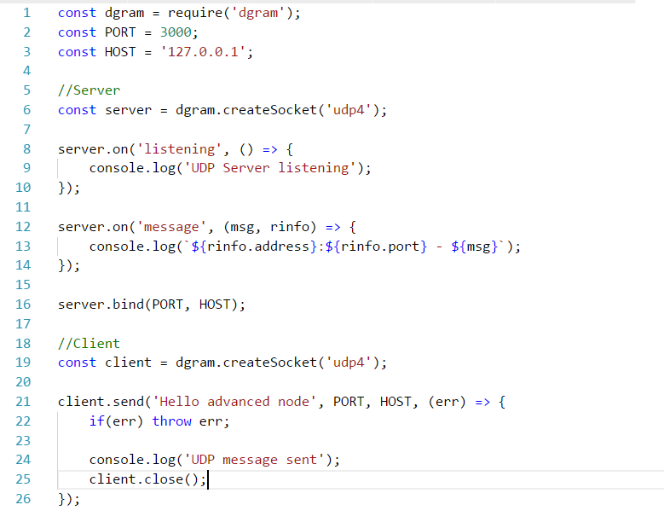
UDP module

Slide 12
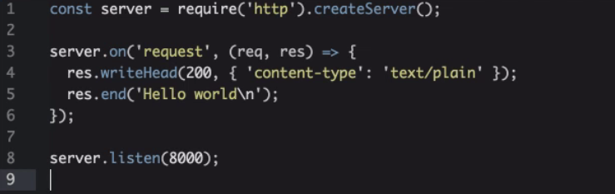
HTTP module

Slide 13
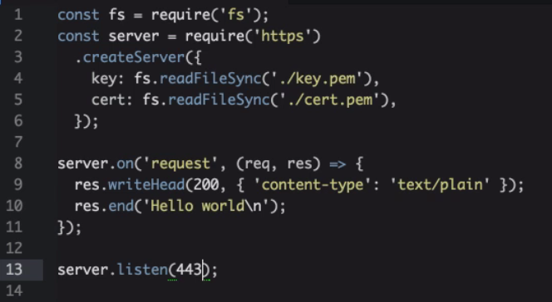
HTTPs module

Slide 14
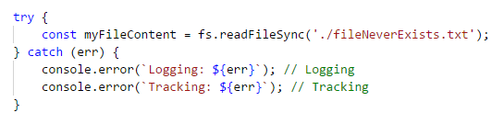
Error handling

Slide 15
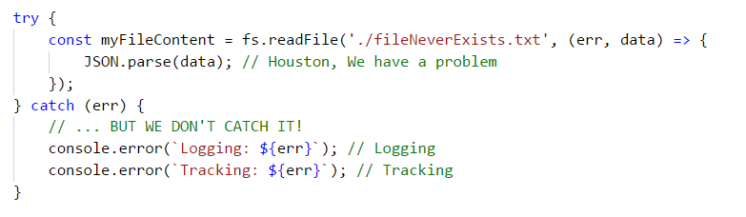
What about this?

Slide 16
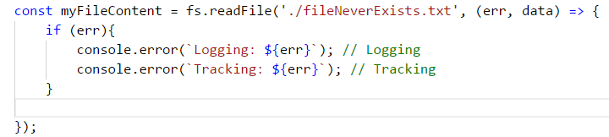
Error handling in callbacks?

Slide 17
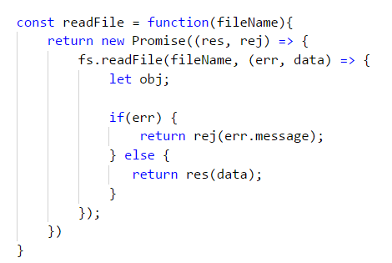
Promises?

Slide 18
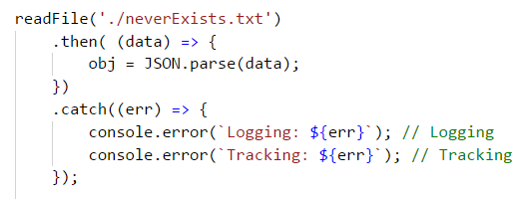
Promises?

Slide 19
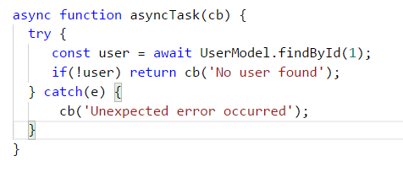
Async/Await?

Slide 20
But, THE STORY IS:
“HOW TO DO THIS PROPERLY”

Slide 21
process.on('uncaughtException')
An unhandled exception means your application – and by extension Node.js itself – is in an undefined state.
If restart application in blindfold may happens everything

Slide 22

process.on('uncaughtException')
It is very raw error handling and can apply in very critical cases

Slide 23
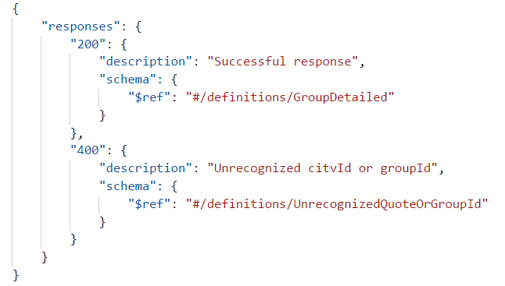
Document API errors using Swagger

Slide 24
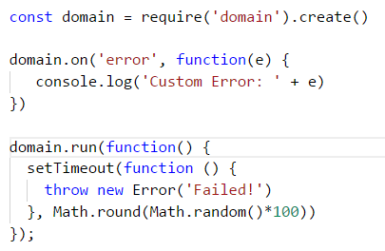
Domain

Slide 25
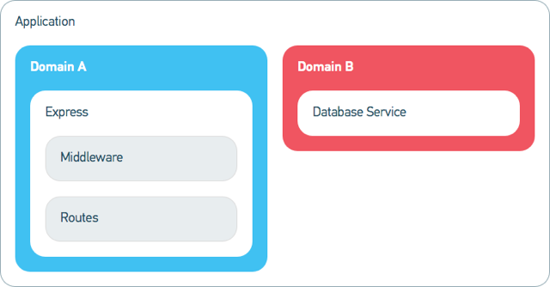
Domain

Slide 26
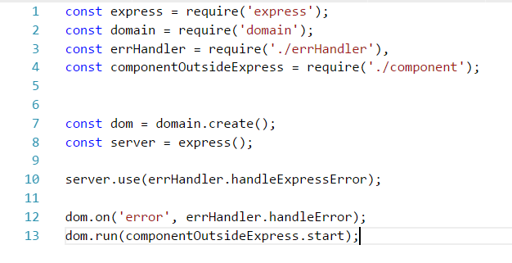
Domain

Slide 27
Domain
Domain node.js module for async exception.
Domain safe async context.

Slide 28
Domain
Domain node.js module for async exception.
Domain safe async context.

Slide 29
Domain
Until version 4.0 domain is obsolete!
Domain will extract to separate npm module.

Slide 30
Async Hooks
The async hooks module provides an API to register callbacks tracking the lifetime of asynchronous resources created inside a Node.js application.

Slide 31
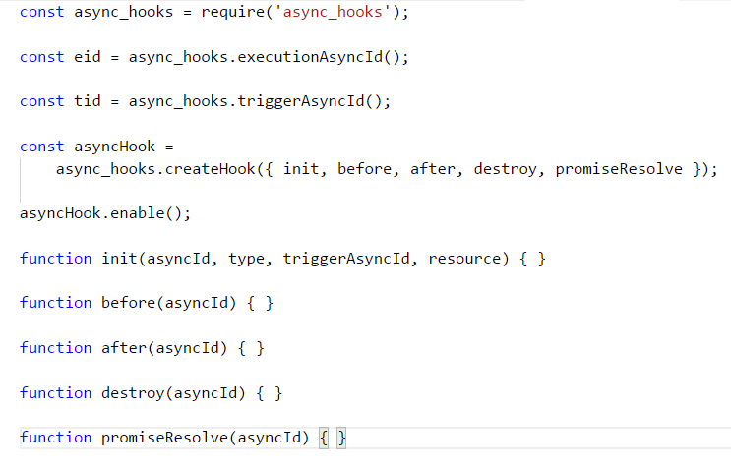
Async Hooks

Slide 32

Async Hooks
Async Hooks is not stable yet!

Slide 33
Error handling best practice
Use Async/Await or promises for async error handling!
Catch unhandled promise rejections.
Use built-in Error object.

Slide 34
Error handling best practice
Handle errors centrally, through but not within middleware!
Document API errors using Swagger.
Shut the process gracefully when a stranger comes to town.
Test error flows using your favorite test framework.
Use Node Domain/Async Hook to isolate errors

Slide 35
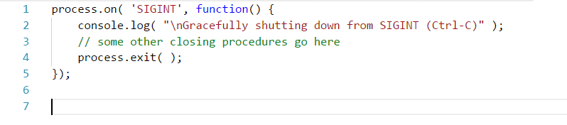
Error handling best practice - Do not forget

Slide 36
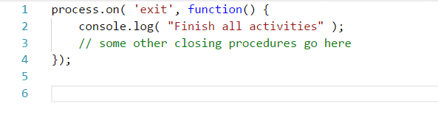
Error handling best practice - Do not forget

Slide 37
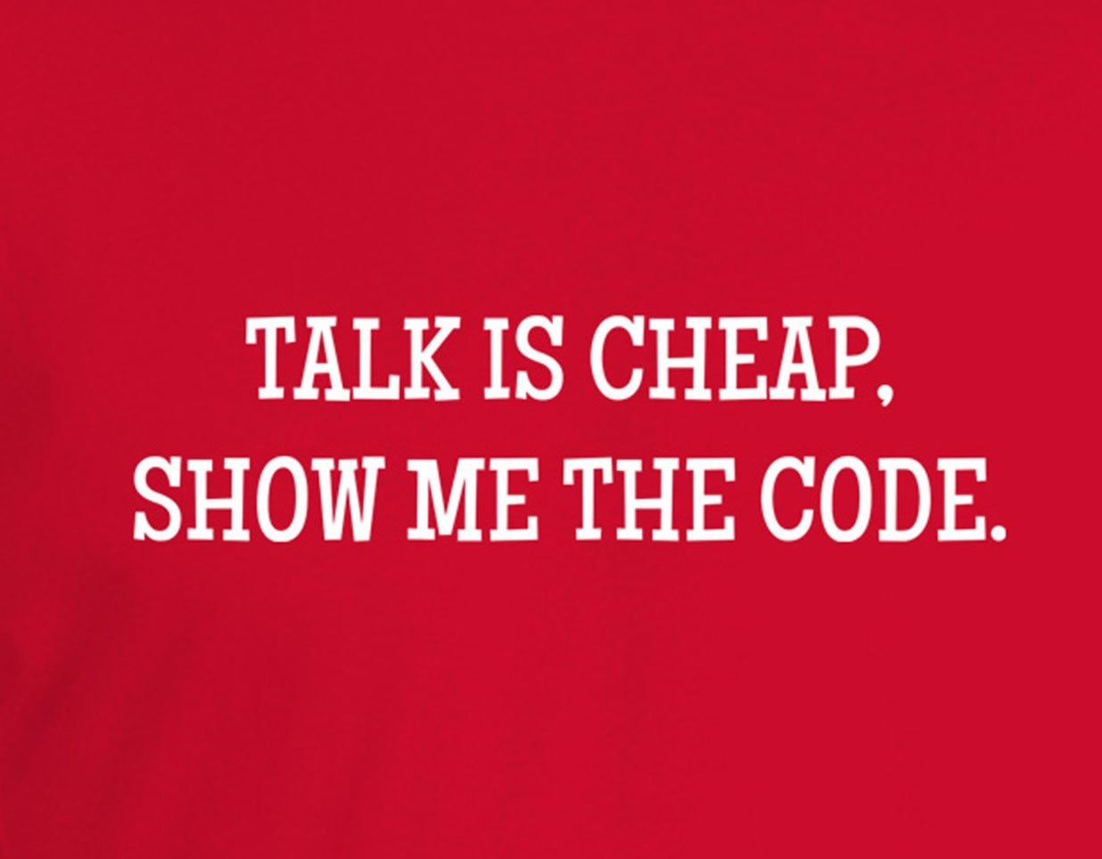
Mocking the require

Slide 38
Thank you for attention

